Slide 1
SC2001 Lab 3
Team 4 LOW ZHAN QI, JODIUS
TAN SHIRLEY
AARON LIM WEE HIM

Slide 2
Table of contents
01
02
03
Knapsack
Recursive Definition
Subproblem Graph
04
05
Dynamic Programming Algorithm
Results

Slide 3
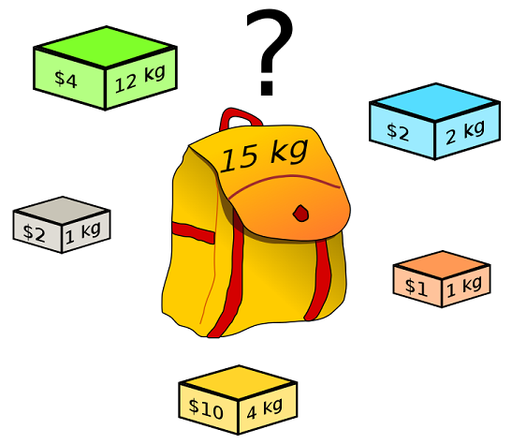
Knapsack
Goal: MAX profit
Constraint:
Weight of objects
Supplies of objects (limited or unlimited)

Slide 4
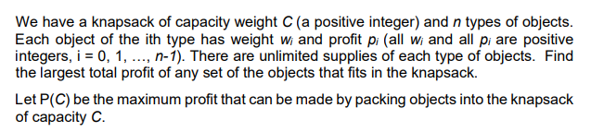
Question a)

Slide 5
02 - Recursive Definition
P(C, n) = 0 when C = 0, n =0 (trivial case)
P(C, n) = max( P(C,n), pi +P(C - Wi,n))
1st Case (last object, i, included)
C = Total weight of knapsack
Wi = weight of LAST object(i)
C - Wi = remaining weight
Profit = pi (Profit of the LAST obj,i)
Remaining obj to choose from n (unlimited supply)
2nd Case (last object, i, not included)
C = Total weight of knapsack
C = remaining weight
No profits as no object is placed
Remaining obj to choose from n (unlimited supply)

Slide 6
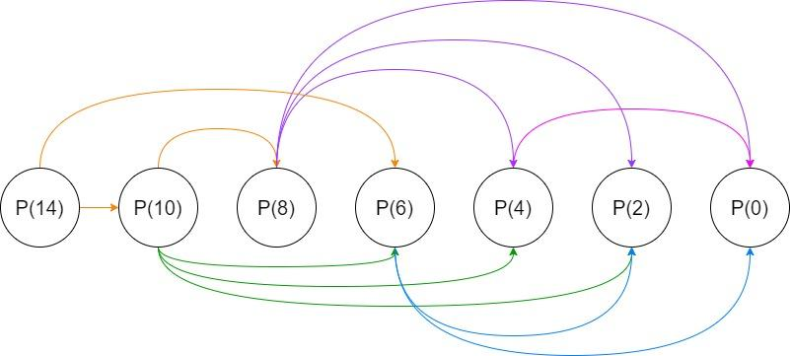
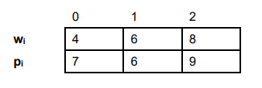
03 – Subproblem Graph
Find dependencies of subproblems

Slide 7
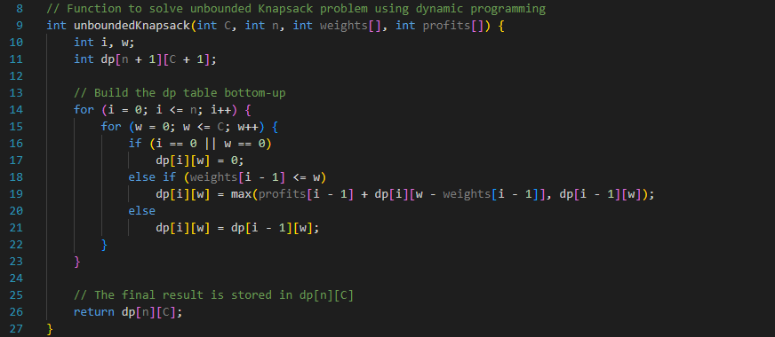
04 – Dynamic Programming Algorithm
Bottom up approach, allow repetition
Initialise 2D array
Base case
Check current weight exceed capacity
If exceed, maximum profit of previous

Slide 8
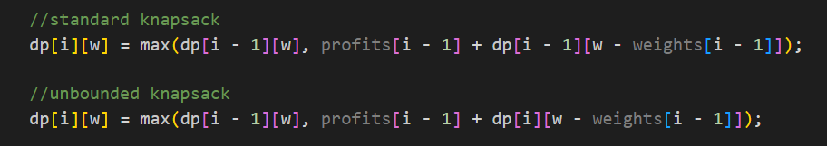
04 – Dynamic Programming Algorithm
Difference

Slide 9

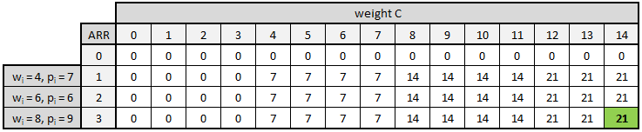
05 – Result for (a)
P(14)
Maximum profit: 21

Slide 10


05 – Result for (b)
P(14)
Maximum profit: 16

Slide 11
Thank you

